Slide 1
Build Real Time Software with ASP.NET Core SignalR
Rachel Appel
Content Developer for Azure / ASP.NET
Microsoft
rachelap@microsoft.com
http://rachelappel.com

Slide 2
Agenda
Overview of SignalR
Configure SignalR and Visual Studio
Hubs
Connections
Deployment

Slide 3
SignalR Overview

Slide 4
Overview: What is SignalR?
Simplifies real time web development
ASP.NET Server and JavaScript Client Libraries
Real-time persistent connection abstraction over HTTP
Simplicity
Reach
Performance
"Incredibly simply real-time web for .NET"
– Damian Edwards, SignalR team
Notes:
Long polling is itself not a true push; long polling is a variation of the traditional polling technique, but it allows emulating a push mechanism under circumstances where a real push is not possible, such as sites with security policies that require rejection of incoming HTTP/S Requests.
With long polling, the client requests information from the server exactly as in normal polling, except it issues its HTTP/S requests (polls) at a much slower frequency. If the server does not have any information available for the client when the poll is received, instead of sending an empty response, the server holds the request open and waits for response information to become available. Once it does, the server immediately sends an HTTP/S response to the client, completing the open HTTP/S Request. In this way the usual response latency (the time between when the information first becomes available and the next client request) otherwise associated with polling clients is eliminated.
For example, BOSH is a popular, long-lived HTTP technique used as a long-polling alternative to TCP when TCP is difficult or impossible to employ directly (e.g., in a web browser);[9] it is also an underlying technology in the XMPP, which Apple uses for its iCloud push support.

Slide 5
Overview: Why Use SignalR?
Types of Apps
Games, leaderboards
Social Applications
Business Collaboration
Stocks
Chat, messaging
Dashboards
Real time forms
Auctions
Anything that needs live data

Slide 6
Overview: Where you can use SignalR
HTML & ASP.NET apps
UWP apps for Windows
Any JavaScript client
Android, iOS, etc… clients

Slide 7
New Features
Rewritten
JavaScript client
No jQuery dependency
Rewritten client access methods
TypeScript
Simplified scale out model
Protocol support: Binary & Test
Custom protocol support
Messagepack

Slide 8
New Features
Simplified connection model
No more automatic reconnects
No more transport dance
Sticky sessions now required
Single hub per connection

Slide 9
Configure SignalR

Slide 10
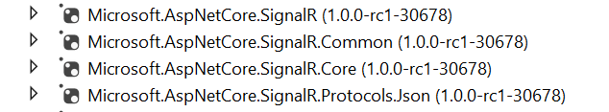
Configure SignalR & Visual Studio
Github.com/aspnet/signalr
ASP.NET Core 2.1 -> Microsoft.AspNetCore.App package built-in
ASP.NET Core 2.0 -> Add in Microsoft.AspNetCore.SignalR
Notes:
Each SignalR app is an OWIN app (open web interface for .net). http://owin.org

Slide 11
SignalR Startup
public class Startup
{
public void Configuration(IAppBuilder app)
{
app.MapSignalR();
}
}
Notes:
Every OWIN Application has a startup class where you specify components for the application pipeline. There are different ways you can connect your startup class with the runtime, depending on the hosting model you choose (OwinHost, IIS, and IIS-Express). The startup class shown in this tutorial can be used in every hosting application. You connect the startup class with the hosting runtime using one of the these approaches: Naming Convention: Katana looks for a class named Startup in namespace matching the assembly name or the global namespace.
OwinStartup Attribute: This is the approach most developers will take to specify the startup class. The following attribute will set the startup class to the TestStartup class in the StartupDemo namespace.[assembly: OwinStartup(typeof(StartupDemo.TestStartup))]The OwinStartup attribute overrides the naming convention. You can also specify a friendly name with this attribute, however, using a friendly name requires you to also use the appSetting element in the configuration file.

Slide 12
DEMO

Slide 13
Using the SignalR Server Side API

Slide 14
Hubs
Microsoft.AspNet.SignalR.Hub class
Server Side Library
Allows for duplex connectivity
Notes:
A Hub is a more high-level pipeline built upon the Connection API that allows your client and server to call methods on each other directly
When server-side code calls a method on the client, a packet is sent across the active transport that contains the name and parameters of the method to be called (when an object is sent as a method parameter, it is serialized using JSON). The client then matches the method name to methods defined in client-side code. If there is a match, the client method will be executed using the deserialized parameter data.
The method call can be monitored using tools like Fiddler. The following image shows a method call sent from a SignalR server to a web browser client in the Logs pane of Fiddler.

Slide 15

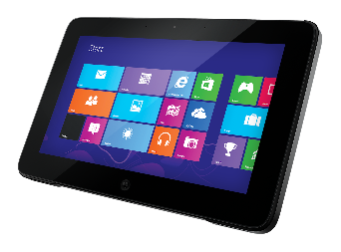
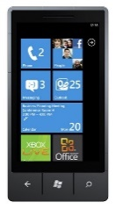

Hubs
?
?
Hub
?

Slide 16
Hubs
Declare public methods on a hub so that clients can call them.
Use the Microsoft.AspNetCore.SignalR.Hub.Clients property to access all clients connected to this hub.
Call a function on the client
Use the HubName and HubMethod attributes to match case
Notes:
http://www.asp.net/signalr/overview/signalr-20/hubs-api/hubs-api-guide-javascript-client
Note: In JavaScript the reference to the server class and its members is in camel case. The code sample references the C# ChatHub class in JavaScript as chatHub

Slide 17
Hub Events
public override Task OnConnected()
{
var id = Context.ConnectionId;
return base.OnConnected();
}

Slide 18
SignalR Transports

Slide 19
Hubs: Transports
A full duplex, TCP based protocol
Is not HTTP
Standardized RFC in 2011
Notes:
From WikiPedia: WebSocket is a protocol providing full-duplex communications channels over a single TCP connection. The WebSocket protocol was standardized by the IETF as RFC 6455in 2011, and the WebSocket API in Web IDL is being standardized by the W3C.
WebSocket is designed to be implemented in web browsers and web servers, but it can be used by any client or server application. The WebSocket Protocol is an independent TCP-based protocol. Its only relationship to HTTP is that its handshake is interpreted by HTTP servers as an Upgrade request.^{[1]} The WebSocket protocol makes possible more interaction between a browser and a web site, facilitating live content and the creation of real-time games.
A full-duplex (FDX) system, or sometimes called double-duplex, allows communication in both directions, and, unlike half-duplex, allows this to happen simultaneously. Land-line telephone networks are full-duplex, since they allow both callers to speak and be heard at the same time.
HTTP is a half duplex system, meaning that it has two way communication but only one way at a time. Like a single elevator in a small building.

Slide 20
Hubs: Transports
Transports
WebSockets is the only transport that establishes a true persistent, two-way connection between client and server.
SSE/Events
AJAX Long Polling
Forever Frame (IE only)
Transport selection process
$.connection.hub.logging = true; // to determine transport
Notes:
Transport selection process
The following list shows the steps that SignalR uses to decide which transport to use.
If the browser is Internet Explorer 8 or earlier, Long Polling is used.
If JSONP is configured (that is, the jsonp parameter is set to true when the connection is started), Long Polling is used.
If a cross-domain connection is being made (that is, if the SignalR endpoint is not in the same domain as the hosting page), then WebSocket will be used if the following criteria are met:
The client supports CORS (Cross-Origin Resource Sharing). For details on which clients support CORS, see CORS at caniuse.com.
The client supports WebSocket
The server supports WebSocket
If any of these criteria are not met, Long Polling will be used. For more information on cross-domain connections, see How to establish a cross-domain connection.
If JSONP is not configured and the connection is not cross-domain, WebSocket will be used if both the client and server support it.
If either the client or server do not support WebSocket, Server Sent Events is used if it is available.
If Server Sent Events is not available, Forever Frame is attempted.
If Forever Frame fails, Long Polling is used.
You can determine what transport your application is using by enabling logging on your hub, and opening the console window in your browser.
To enable logging for your hub's events in a browser, add the following command to your client application:
$.connection.hub.logging = true;

Slide 21
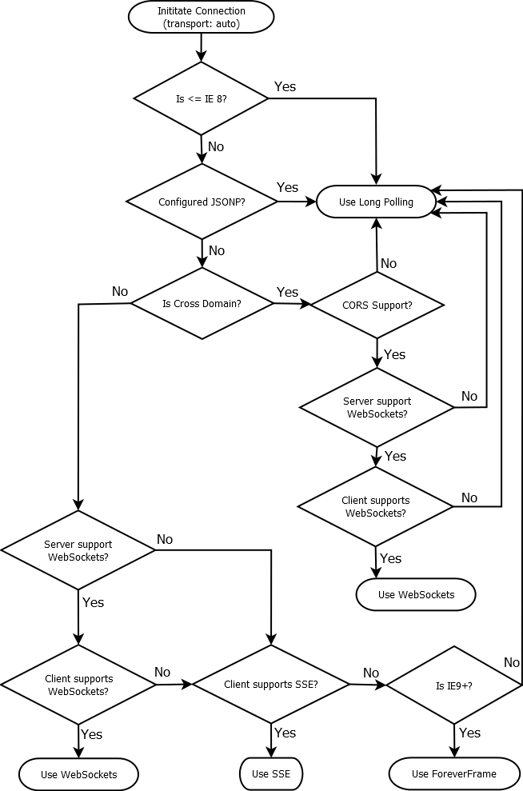
From this SO thread
http://stackoverflow.com/questions/16983630/how-does-signalr-decide-which-transport-method-to-be-used
From this SO user, thomaswr
http://stackoverflow.com/users/2207506/thomaswr

Slide 22
DEMO: Hubs

Slide 23
Using the SignalR JS API

Slide 24
SignalR Client Script Libraries
SignalR no longer depends on jQuery
<script src="signalr.js"></script>

Slide 25
Connections
Client Side
Notes:
A Connection represents a simple endpoint for sending single-recipient, grouped, or broadcast messages
When OnConnected, OnDisconnected, and OnReconnected are called
Each time a browser navigates to a new page, a new connection has to be established, which means SignalR will execute the OnDisconnected method followed by the OnConnected method. SignalR always creates a new connection ID when a new connection is established.
The OnReconnected method is called when there has been a temporary break in connectivity that SignalR can automatically recover from, such as when a cable is temporarily disconnected and reconnected before the connection times out. The OnDisconnected method is called when the client is disconnected and SignalR can't automatically reconnect, such as when a browser navigates to a new page. Therefore, a possible sequence of events for a given client is OnConnected, OnReconnected, OnDisconnected; or OnConnected,OnDisconnected. You won't see the sequence OnConnected, OnDisconnected, OnReconnected for a given connection.
The OnDisconnected method doesn't get called in some scenarios, such as when a server goes down or the App Domain gets recycled. When another server comes on line or the App Domain completes its recycle, some clients may be able to reconnect and fire the OnReconnected event.
For more information, see Understanding and Handling Connection Lifetime Events in SignalR.
$.connection.hub.logging = true; // to verify the transport (websockets or a fallback like comet or forever frame
connection.start({ transport: 'longPolling' });You can specify a fallback order if you want a client to try specific transports in order. The following code snippet demonstrates trying WebSocket, and failing that, going directly to Long Polling.
connection.start({ transport: ['webSockets','longPolling'] });

Slide 26
Connections: Communications
Hub to Connection
Connection to Hub
Connection to Connection
Specific Connections

Slide 27
SignalR Lifecycle
http://www.asp.net/signalr/overview/guide-to-the-api/handling-connection-lifetime-events#connectiontimeout
Notes:
http://www.asp.net/signalr/overview/guide-to-the-api/handling-connection-lifetime-events#connectiontimeout

Slide 28
DEMO: Connect to Hubs

Slide 29
Using the SignalR Client Side API

Slide 30
Session State
Nope nope nope it doesn't support it
It bypasses ASP.NET
No HttpContext object
Notes:
SignalR connections (including the connection underlying all Hub operations for a client) do not support Session state. You could enable it if you wanted to but we'd strongly recommend against it as session state access serializes requests for a given client, meaning you won't really get the benefit from SignalR duplex messaging anymore, as one request will block the other e.g. in the long polling transport, the receiving connection will block any attempt to send.

Slide 31
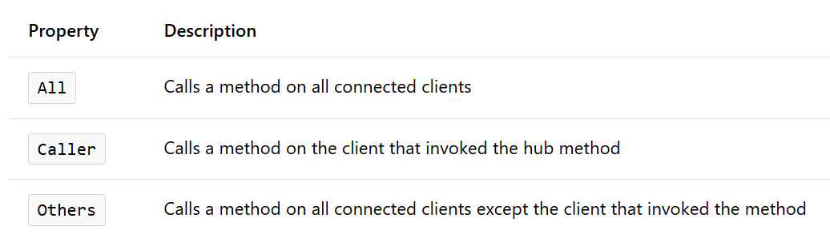
Hub.Clients

Slide 32
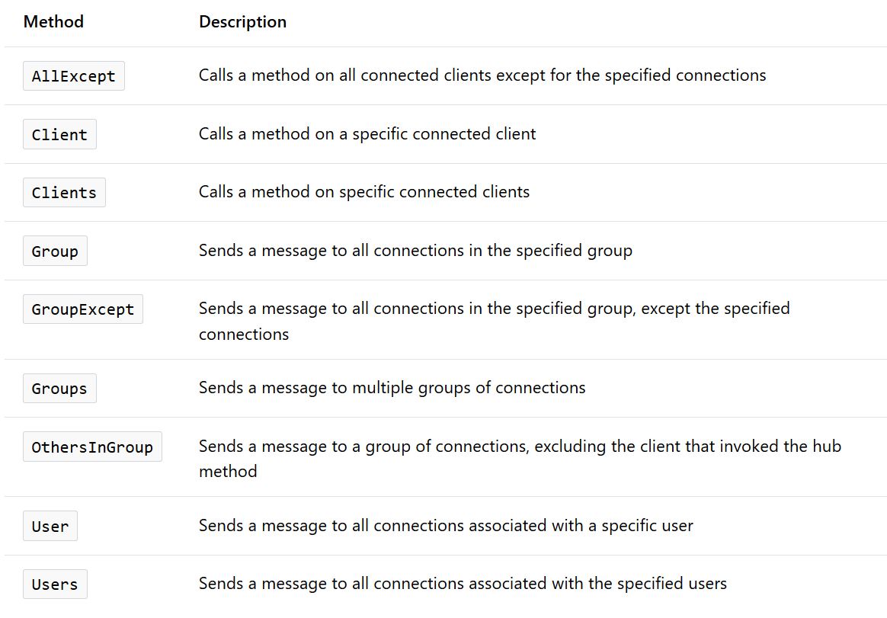
Hub.Clients

Slide 33
Send data via QueryString
Context.Request
Headers
QueryString
// .NET client
var connection = new HubConnection("http://localhost:8080/", "data=12345");
// JavaScript client
$.connection.hub.qs = "data=12345";
// Hub server code
var qs = Context.Request.QueryString["myInfo"].ToString();
Notes:
var connection = new HubConnection("http://localhost:8080/", "myInfo=12345"); // .NET client
$.connection.hub.qs = "myInfo=12345"; // the js client
Context.Request.QueryString["myInfo"].ToString(); // in hub code on server

Slide 34
Connection Status
Notify the client of slow or unavailable connectivity
$.connection.hub.connectionSlow(function () {
notifyUserOfConnectionProblem();
})
$.connection.hub.reconnecting(function () {
notifyUserOfReconnection();
});
Notes:
How to notify the user about disconnections
In some applications you might want to display a message to the user when there are connectivity problems. You have several options for how and when to do this. The following code samples are for a JavaScript client using the generated proxy.
Handle the connectionSlow event to display a message as soon as SignalR is aware of connection problems, before it goes into reconnecting mode.
$.connection.hub.connectionSlow(function() { notifyUserOfConnectionProblem(); // Your function to notify user. });
Handle the reconnecting event to display a message when SignalR is aware of a disconnection and is going into reconnecting mode.
$.connection.hub.reconnecting(function() { notifyUserOfTryingToReconnect(); // Your function to notify user. });

Slide 35
DEMO: Clients

Slide 36
Security
Integrate SignalR into existing authentication
ASP.NET Forms
Authorize attribute
Notes:
http://www.asp.net/signalr/overview/security/introduction-to-security
SignalR does not provide any features for authenticating users. Instead, you integrate the SignalR features into the existing authentication structure for an application. You authenticate users as you would normally in your application, and work with the results of the authentication in your SignalR code. For example, you might authenticate your users with ASP.NET forms authentication, and then in your hub, enforce which users or roles are authorized to call a method. In your hub, you can also pass authentication information, such as user name or whether a user belongs to a role, to the client.

Slide 37
Securing Hubs
[Authorize]
[Authorize(Roles = "Admin")]
public class AdminAuthHub : Hub { }
[Authorize(Users = "User1, User2")]
public class AdminAuthHub : Hub { }
// try to avoid securing individuals
Notes:
[Authorize] – only authenticated users
[Authorize(Roles = "Admin,Manager")] – only authenticated users in the specified roles
[Authorize(Users = "user1,user2")] – only authenticated users with the specified user names
[Authorize(RequireOutgoing=false)] – only authenticated users can invoke the hub, but calls from the server back to clients are not limited by authorization, such as, when only certain users can send a message but all others can receive the message. The RequireOutgoing property can only be applied to the entire hub, not on individuals methods within the hub. When RequireOutgoing is not set to false, only users that meet the authorization requirement are called from the server.

Slide 38
Require Authentication for all Hubs
public partial class Startup {
public void Configuration(IAppBuilder app) {
app.MapSignalR();
GlobalHost.HubPipeline.RequireAuthentication();
}
}
Notes:
You can require authentication for all hubs and hub methods in your application by calling the RequireAuthentication method when the application starts. You might use this method when you have multiple hubs and want to enforce an authentication requirement for all of them. With this method, you cannot specify requirements for role, user, or outgoing authorization. You can only specify that access to the hub methods is restricted to authenticated users. However, you can still apply the Authorize attribute to hubs or methods to specify additional requirements. Any requirement you specify in an attribute is added to the basic requirement of authentication.

Slide 39
Pass Authentication to Client
var user = Context.User;
var name = user.Identity.Name;

Slide 40
Deploying SignalR

Slide 41
SignalR Deployment
Azure SDK
Deployment To-Do's
Enable WebSockets
Leave ARR Affinity
Add extensions
Notes:
You can use the Windows Azure Service Bus Backplane for multiple instances of Azure
http://www.asp.net/signalr/overview/signalr-20/getting-started-with-signalr-20/using-signalr-with-windows-azure-web-sites

Slide 42
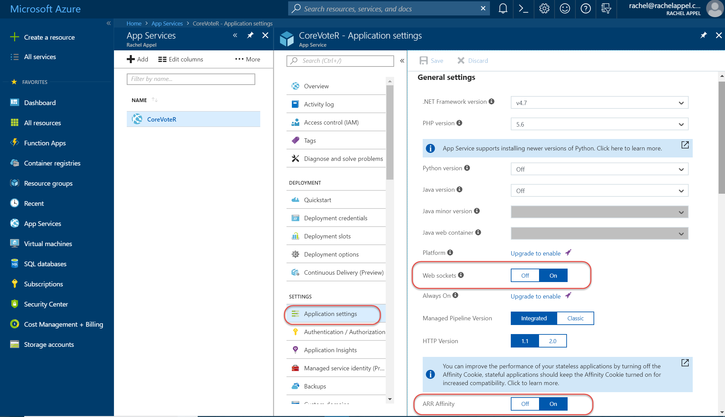

Slide 43
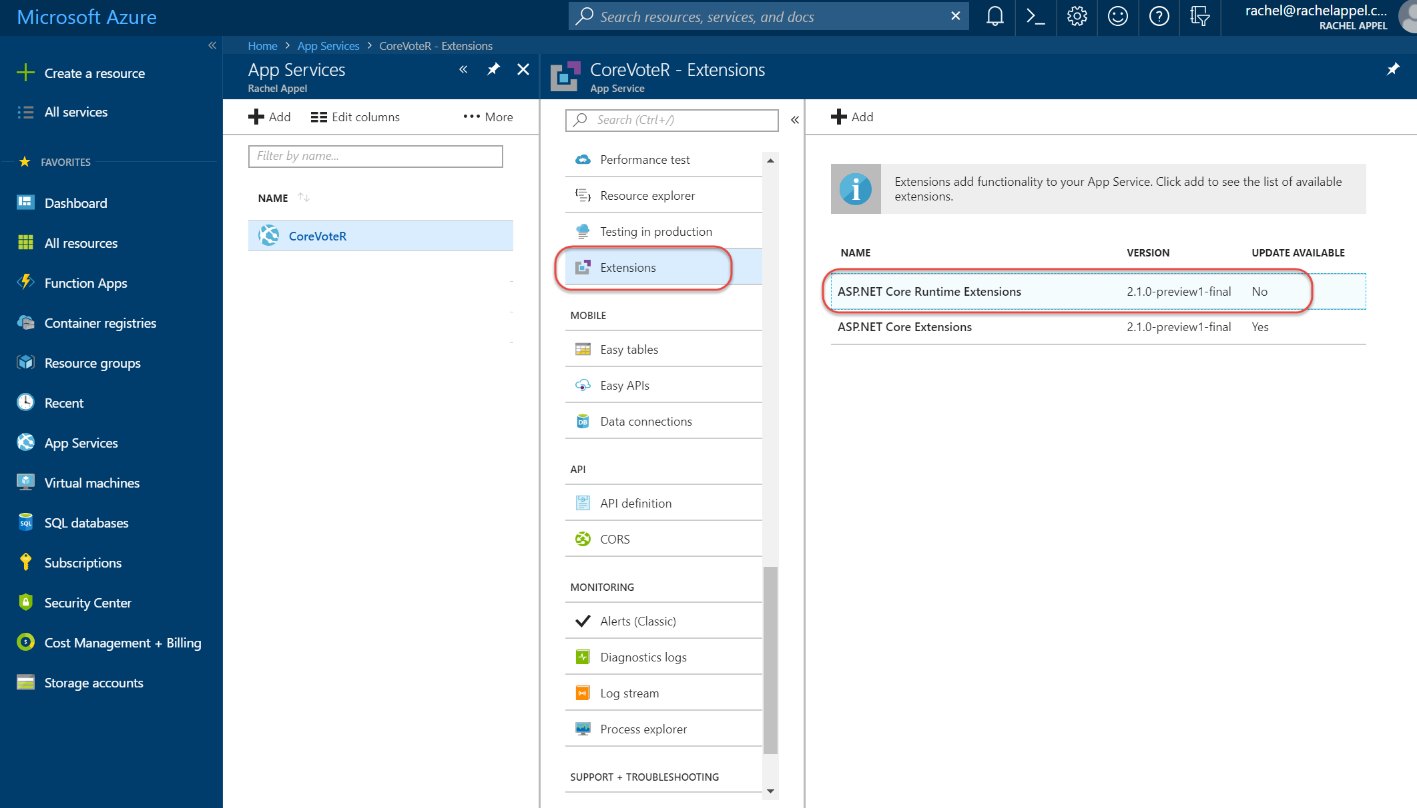

Slide 44
Thank you

